Slide 1
SMART CITIES TECHNOLOGY E020-01-2367/2020 TELECOMMUNICATION AND INFORMATION ENGINEERING STUDENT

Slide 2
TABLE OF CONTENT
Introduction
The necessity for smart cities
The role of Telecommunication and Information engineering in the development of smart cities.
Conclusion
References

Slide 3
INTRODUCTION
Smart cities use a variety of software, user interfaces and communication networks alongside the Internet of Things (IoT) to deliver connected solutions for the public. Of these, the IoT is the most important. The IoT is a network of connected devices that communicate and exchange data. This can include anything from vehicles to home appliances and on-street sensors. Data collected from these devices is stored in the cloud or on servers to allow for improvements to be made to both public and private sector efficiencies and deliver economic benefits and improvements to the lives of citizens.

Slide 4
smart city Technologies
Smart cities use a variety of software, user interfaces and communication networks alongside the Internet of Things (IoT) to deliver connected solutions for the public.Besides IOTs they use the following other softwares:
Application Programming Interfaces (APIs)
Artificial Intelligence (AI)
Cloud Computing Services
Dashboards
Machine Learning
Machine-to-Machine Communications
Mesh Networks

Slide 5
How smart cities work
Smart cities follow four steps to improve the quality of life and enable economic growth through a network of connected IoT devices and other technologies. These steps are as follows:
1. Collection – Smart sensors gather real-time data
2. Analysis – The data is analysed to gain insights into the operation of city services and operations
3. Communication – The results of the data analysis are communicated to decision makers
4. Action – Action is taken to improve operations, manage assets and improve the quality of city life for the residents

Slide 6
Neccesity of smart cities
Smart cities that leverage connected technology across their operations reap a host of benefits as outlined;
More effective, data-driven decision-making
Enhanced citizen and government engagement
Safer communities
Reduced environmental footprint
Improved transportation

Slide 7
cont.
6.Increased digital equity
7.New economic development opportunities
8.Efficient public utilities
9.Improved infrastructure
10.Improved infrastructure
Smart city technology can make cities more effective and efficient, which is necessary given the projected rapid growth in urban populations over the next few decades.

Slide 8
Role of Telecommunication engineering in development of smart cities
A smart city uses technology and data to enhance urban management, increase resource efficiency, and enhance the quality of life for its citizens. Among the various disciplines driving this transformative change, Telecommunication engineering stands out. Let’s explore the pivotal role of electrical engineering in the development of smart cities and its impact on shaping our urban future.

Slide 9
cont.
Smart Grids and Energy Management
One of the fundamental pillars of a smart city is its energy management system. To create and execute smart grids that enable effective energy distribution, renewable energy integration, and demand-side management, Telecommunication and information engineering is essential. Through advanced sensors, communication networks, and data analytics, electrical engineers ensure a reliable and sustainable energy supply, reducing carbon footprints and promoting energy conservation in smart cities.

Slide 10
Smart Buildings and Infrastructure
Telecommunication engineering plays a central role in transforming traditional buildings into smart, energy-efficient structures. Advanced building automation systems are designed and implemented by electrical engineers who incorporate technologies like smart lighting, energy management, and HVAC systems. These systems optimise energy consumption, enhance occupant comfort, and improve overall building performance, contributing to the sustainability and resilience of smart cities.

Slide 11
cyber security and resilience
As smart cities become more connected and reliant on digital technologies, ensuring cybersecurity and resilience becomes paramount. Telcommunication engineers are at the forefront of developing secure communication networks, robust infrastructure, and effective cybersecurity measures. They work to safeguard critical systems, protect sensitive data, and mitigate cybersecurity risks. By addressing these challenges, electrical engineers enable smart cities to operate securely and maintain the trust of their residents.

Slide 12
Global Impact and Career Opportunities
Global Impact and Career Opportunities
The role of electrical engineering in the development of smart cities extends beyond borders.re is a glod for experts in this industry due to the rising need for sustainable urban solutions. By pursuing a career in electrical engineering focused on smart cities, you open yourself up to a wide range of opportunities worldwide. Your electrical engineering knowledge and abilities will be in great demand, whether you work for the government, research institutes, technology corporations, or consulting organisations.
The role of telecommunication and information engineering in the development of smart cities extends beyond borders. There is a global need for experts in this industry due to the rising need for sustainable urban solutions. By pursuing a career in electrical engineering focused on smart cities, you open yourself up to a wide range of opportunities worldwide. Your electrical engineering knowledge and abilities will be in great demand, whether you work for the government, research institutes, technology corporations, or consulting organisations.

Slide 13

smart city

Slide 14
Examples of smart Cities in the world
Cities across the world are in different stages of smart technology development and implementation. However, there are several who are ahead of the curve, leading the path to creating fully smart cities. These include:
Tokyco , Japan
Barcelona, Spain
Columbus, Ohio, USA
Dubai, United Arab Emirates
Hong Kong, China
Kansas City, Missouri, USA
London, England
Melbourne, Australia
New York City, New York, USA
Reykjavik, Iceland
Toronto, Canada
Vienna, Austria

Slide 15
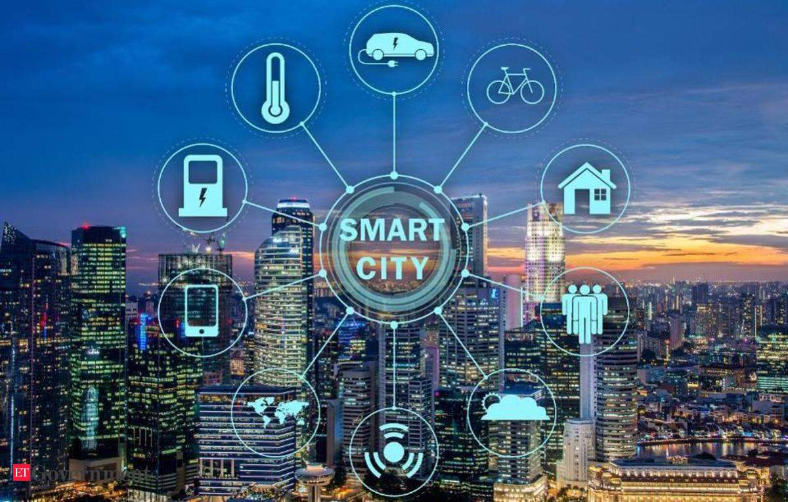
smart city integration

Slide 16
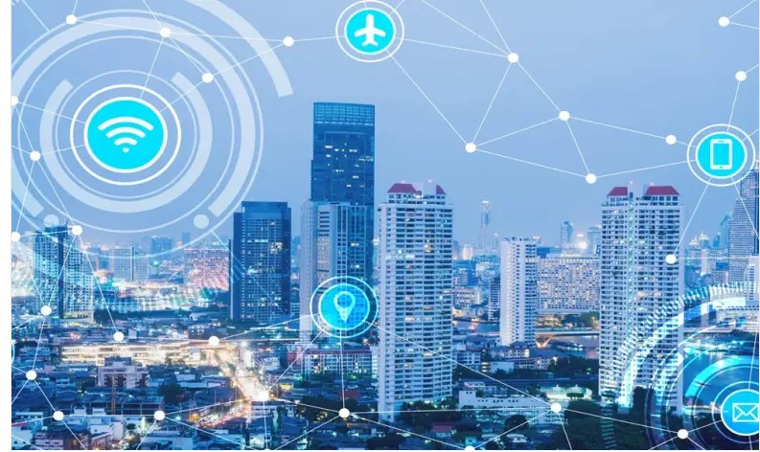
examples

Slide 17
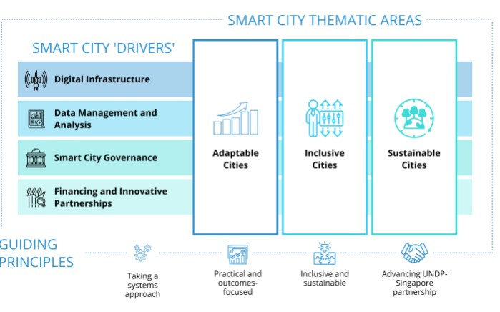
UN Approach

Slide 18
CONCLUSION
Creating smart connected systems for our urban areas provides a great many benefits for citizens around the world, not only to improve quality of life, but also to ensure sustainability and the best possible use of resources.
These solutions are dependent on a unified approach from government as well as the private sector and residents themselves. With the correct support and infrastructure, however, smart cities can use advances such as the Internet of Things to enhance the lives of residents and create joined-up living solutions for the growing global urban citizenry.

Slide 19
REFERENCES
rwant Singh (19 June 2014). "Smart Cities – A$1.5 Trillion Market Opportunity". Forbes. Archived from the original on 3 November 2014. Retrieved 4 November 2014.
Giffinger, Rudolf; Christian Fertner; Hans Kramar; Robert Kalasek; Nataša Pichler-Milanovic; Evert Meijers (2007). "Smart cities – Ranking of European medium-sized cities" (PDF). Smart Cities. Vienna: Centre of Regional Science. Archived from the original on 9 April 2011. Retrieved 13 November 200
"IEEE Smart Cities". Institute of Electrical and Electronics Engineers. 23 April 2019. Archived from the original on 23 April 2019.
Pribyl, Ondrej; Svitek, Miroslav; Rothkrantz, Leon (28 March 2022). "Intelligent Mobility in Smart Cities". Applied Sciences. 12 (7): 3440. doi:10.3390/app12073440. Retrieved 28 August 2022.
Kline, Katie (26 https://standards.ieee.org/beyond-standards/what-a-smart-city-is-all-about
"Definitions and overviews". Smart Cities Council. 1 May 2013. Archived from the original on 3 November 2014. The smart city sector is still in the 'I know it when I see it' phase, without a universally agreed definition. The Council defines a smart city as one that has digital technology embedded across all city functions;

Slide 20
cont.
Hollands, R. G (2008). "Will the real smart city please stand up?". City. 12 (3): 303–320. doi:10.1080/13604810802479126. S2CID 143073956.
Johns, Fleur (13 October 2021). "Governance by Data". Annual Review of Law and Social Science. 17 (1): 53–71. doi:10.1146/annurev-lawsocsci-120920-085138. ISSN 1550-3585. S2CID 235546816. Retrieved 27 August 2022.
Deakin, M (2007). "From city of bits to e-topia: taking the thesis on digitally-inclusive regeneration full circle". Journal of Urban Technology. 14 (3): 131–143. Archived from the original on 18 March 2016. Retrieved 3 November 2014.

